Slide 1
Title Operational Dynamics and Performance Evaluation of Induction Motors
Presented By:
Name: Chinmoy Debnath & Name: Promod Chandra Das
Id: 231902029 Id: 231002005
Department: CSE Departmet: CSE
Subject: Electrical Drives and Instrumentation
Section: 231_D2
Presented To: Monjila Afrin Dorothi
01

Slide 2
Agenda
Introduction
Classifications
Working Principle
Synchronous Speed
Slip
Operational Dynamics
Torque Speed Characteristics
Losses in Induction Motors
Performance Testing
Speed Control Methods
Advantages
Limitations
Conclusion
02

Slide 3
Introduction
An induction motor works on the principle of electromagnetic induction.
It always runs on AC supply.
Converts AC electrical power → mechanical power
Called the workhorse of industry.
Widely used in commercial, and domestic applications.
03

Slide 4
Classification
By construction:
Squirrel cage (single & double cage)
Slip ring (phase wound)
By supply:
Single-phase
Three-phase
04

Slide 5
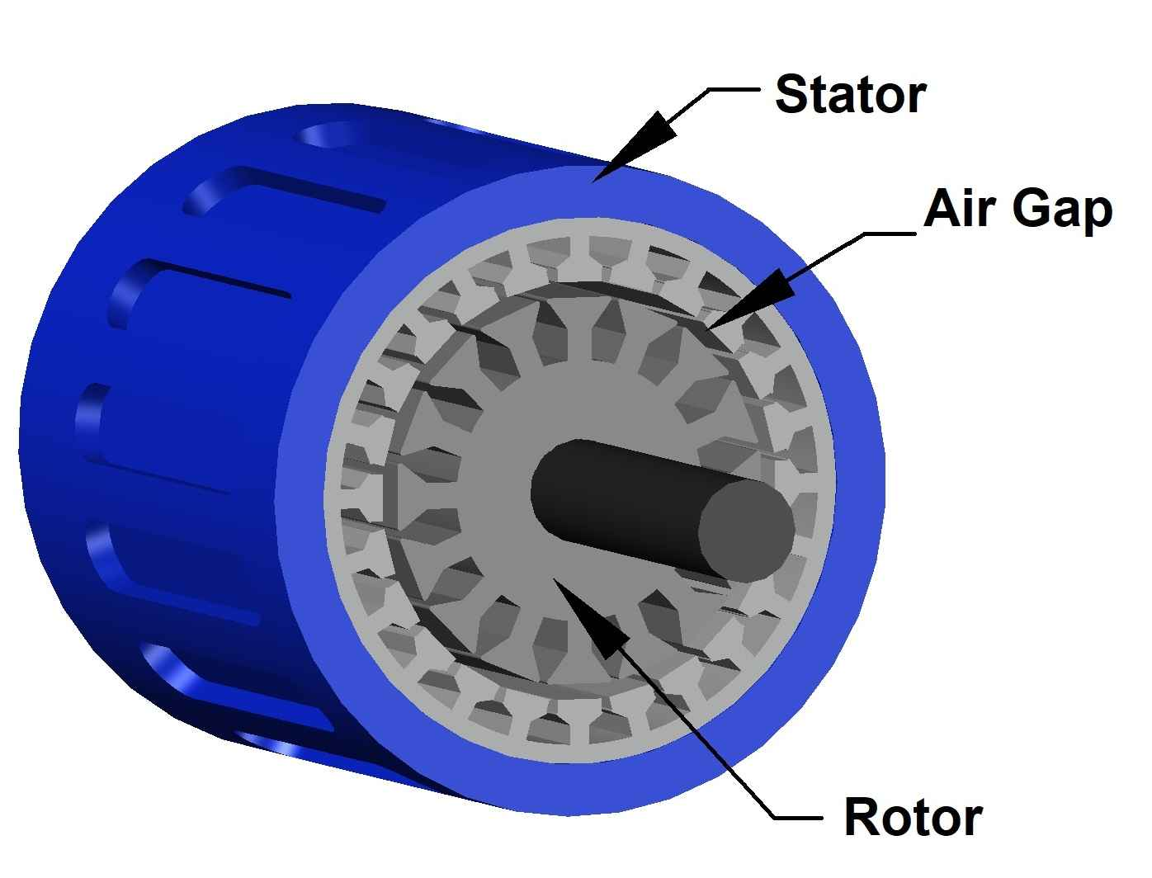
Main Parts
Stator: stationary, AC windings, produces RMF
Rotor: rotating, squirrel cage or wound rotor
Air gap for magnetic coupling
The air gap length affects the magnetic coupling and overall efficiency of the motor.
Figure : 1
05

Slide 6
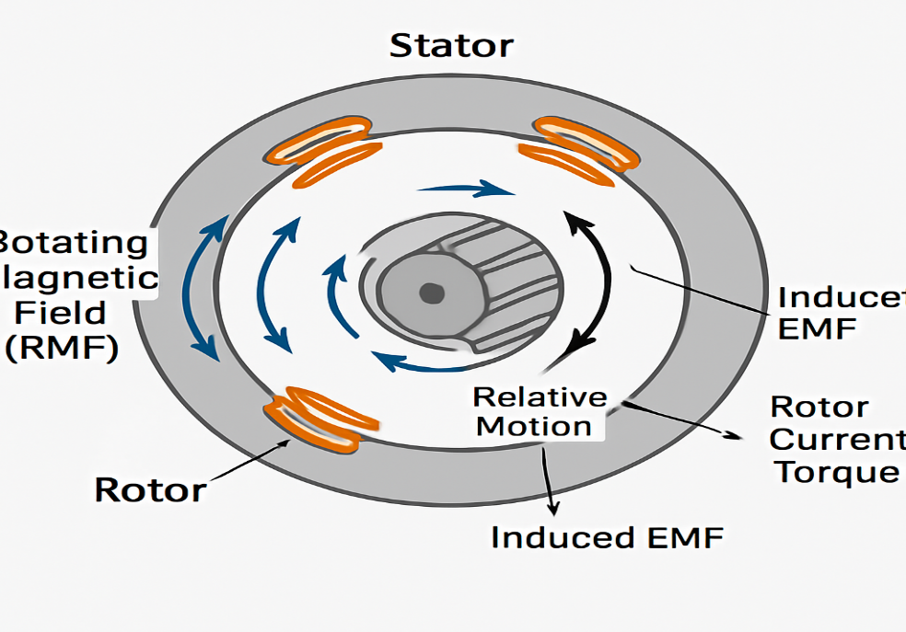
Working Principle
AC supply → rotating magnetic field (RMF)
RMF cuts rotor → induces EMF (Faraday’s law)
Rotor current produces torque (Lenz’s law)
Rotor never reaches synchronous speed
The difference in speed between the RMF and rotor (slip) is
essential for continuous torque production.
Figure: 2
06

Slide 7
Synchronous Speed
Synchronous speed is the speed of the stator’s rotating magnetic field.
It depends on supply frequency and number of poles in the motor.
Higher frequency → higher synchronous speed.
More poles → lower synchronous speed.
07

Slide 8
Slip
Slip is the difference between synchronous speed and rotor speed.
It is necessary for torque production.
Slip is zero only at synchronous speed (which rotor never actually reaches).
Typical slip values:
Starting: 100% (rotor stationary)
Full load: 1% to 5%
08

Slide 9
Operational Dynamics
Load ↑ → Rotor slows → Slip ↑ → Torque ↑
Load ↓ → Rotor speeds up → Slip ↓ → Torque ↓
Rotor frequency ∝ Slip
Zero slip → Zero rotor frequency
This balance keeps motor running under load changes
09

Slide 10
Torque–Speed Characteristics
Torque is low at starting (zero speed).
Torque increases rapidly to reach breakdown (maximum) torque.
After breakdown torque, torque decreases as speed approaches synchronous speed.
Motor operates between start and synchronous speed under load.
Torque-speed curve shows motor’s ability to handle different loads safely.
10

Slide 11
Losses in Induction Motors
Stator copper losses occur due to resistance in stator windings (I²R).
Rotor copper losses are caused by current flowing in rotor conductors (I²R).
Core losses include hysteresis and eddy current losses in the iron core.
Mechanical losses arise from friction in bearings and air resistance (windage).
Minimizing these losses improves motor efficiency and performance.
11

Slide 12
Performance Testing
No-load test measures core and mechanical losses with no load on the motor.
Blocked rotor test determines stator and rotor copper losses at locked rotor.
Load test evaluates actual motor performance under working conditions.
Tests help calculate efficiency, power factor, and torque characteristics accurately.
12

Slide 13
Speed Control Methods
From stator side: Change voltage, frequency, or poles.
From rotor side: Rheostat, injected EMF, cascade connection,
Injected EMF and cascade connection are specialized rotor-side techniques for speed variation.
13

Slide 14
Advantages
Rugged construction ensures long-lasting operation.
Simple design leads to easy manufacturing and repair.
Requires minimal maintenance compared to other motors.
Cost-effective and widely available for industrial use.
Quiet operation with smooth torque delivery.
14

Slide 15
Limitations
Speed is mostly fixed by supply frequency, limiting flexibility.
High starting current can stress electrical systems.
Poor power factor at light or no-load conditions reduces efficiency.
Less suitable for precise speed control without additional equipment.
Lower starting torque compared to some other motor types (like DC motors).
15

Slide 16
Conclusion
Operational dynamics explain how the motor reacts to load and slip.
Performance evaluation ensures efficiency, reliability, and suitability for application.
Understanding operational dynamics helps in selecting the right motor for specific load conditions.
Regular performance evaluation aids in early detection of faults and prolongs motor life.
16

Slide 17

Any Questions ?
17

